Slide 1
Colossal Patterns Mining
By:
Bharat Sharma [ 16IT210 ]
Bhavya Bordia [16IT212 ]
Sulabh Temulkar [16IT245]
Abhishek Kamal [16IT202]

Slide 2
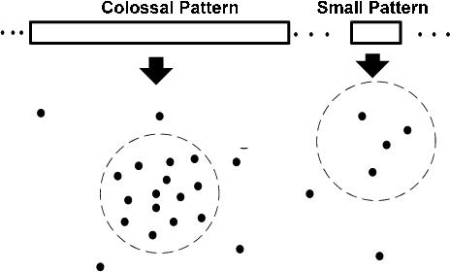
Colossal Pattern
only very large (colossal) patterns are extracted and mined in this approach.
Due to ignoring the mining of the small and mid-sized patterns, mining process speed is increased.

Slide 3
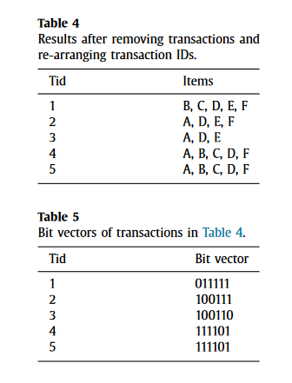
Example Data And Bit Vectors

Slide 4
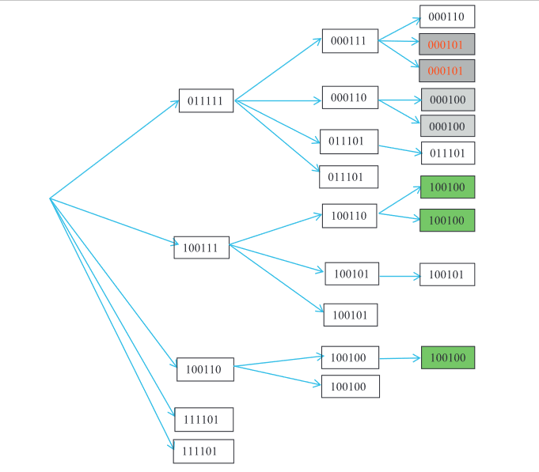
Searching Tree Using CP-Tree

Slide 5
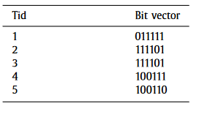
Sorting Before PCP

Slide 6
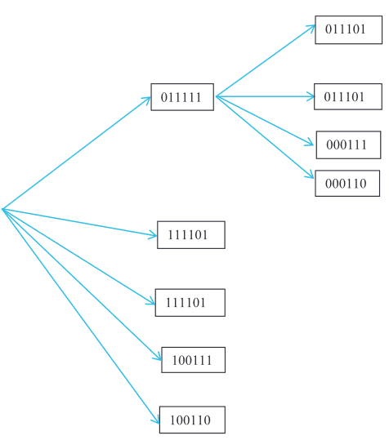
PCP: CP-tree after extending to Level 2 of node {011111,1}

Slide 7
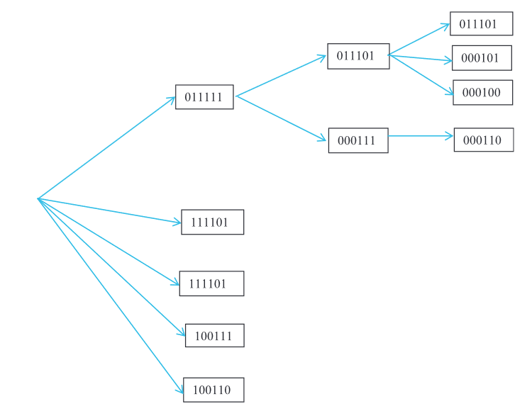
PCP: CP-tree after extending to Level 3 of node {011111, 1}.

Slide 8
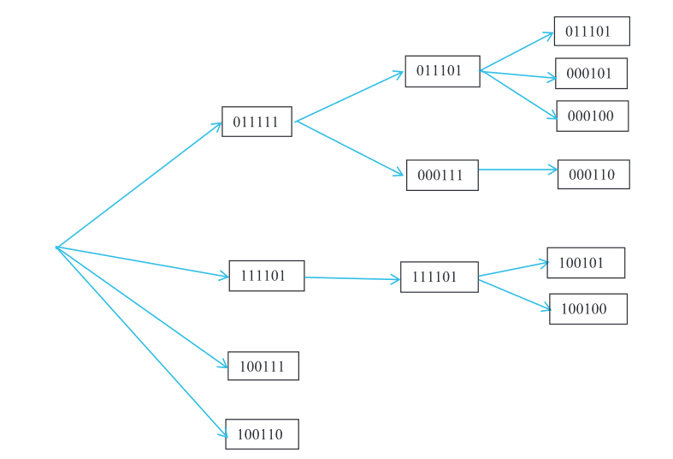
Final CP-tree of the PCP-Miner algorithm.

Slide 9
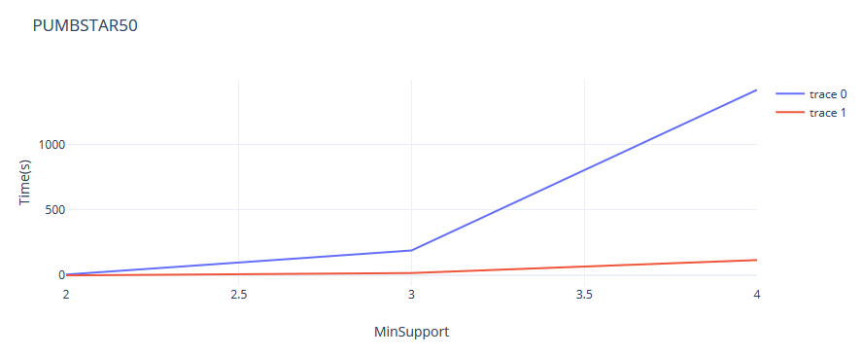
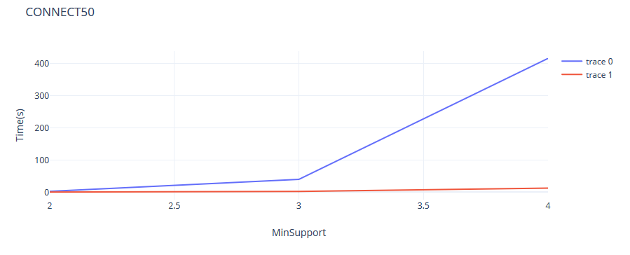
Results

Slide 10
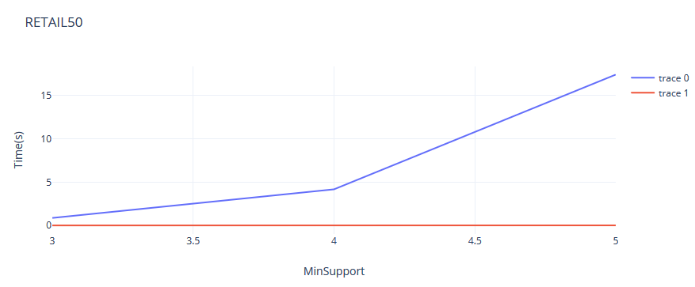
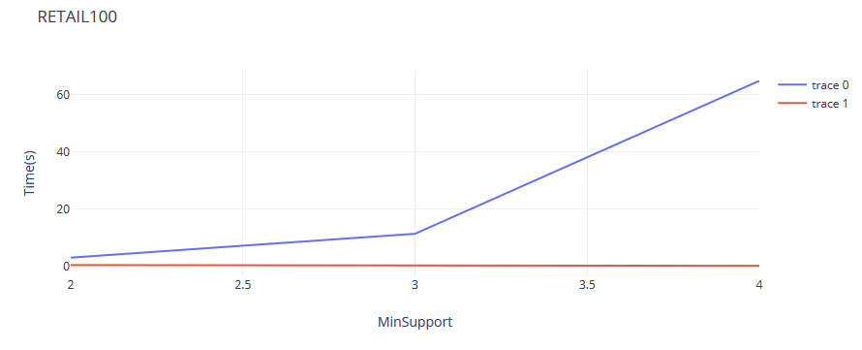
Results

Slide 11
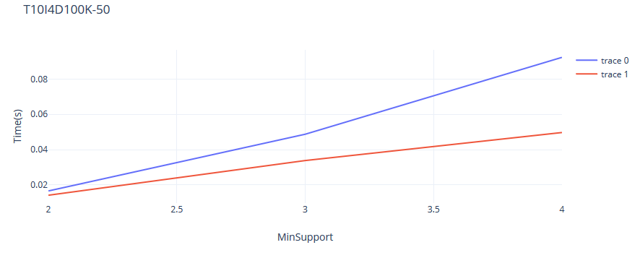
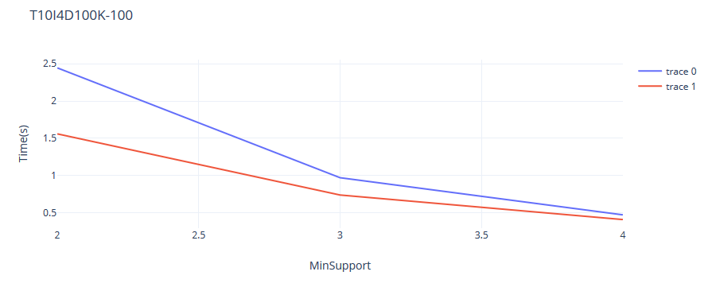
Results

